Slide 1
Healthcare Provider Fraud Detection
MACHINE LEANING
Done By:
Yahia Moataz
Mohamed Azzam
Ahmed Ghazaly
Abdelrahman Mohamed
Ziad Ahmed

Slide 2
THE ISSUE
Healthcare fraud costs $68 billion annually in the U.S
Current System Limitations:
  • Rule-based methods only catch obvious patterns
  • CMS can only investigate a small fraction of cases
  • Sophisticated fraud schemes go undetected
Our Mission is to Build an intelligent, data-driven fraud detection system to solve these limitations

Slide 3
TYPES OF HEALTHCARE FRAUD
Common Fraud Schemes:
• Billing for services never rendered
• Upcoding - billing for expensive procedures
• Unbundling - separating bundled procedures
• Claims for deceased patients
• Unnecessary treatments for profit
• Kickback and referral schemes

Slide 4
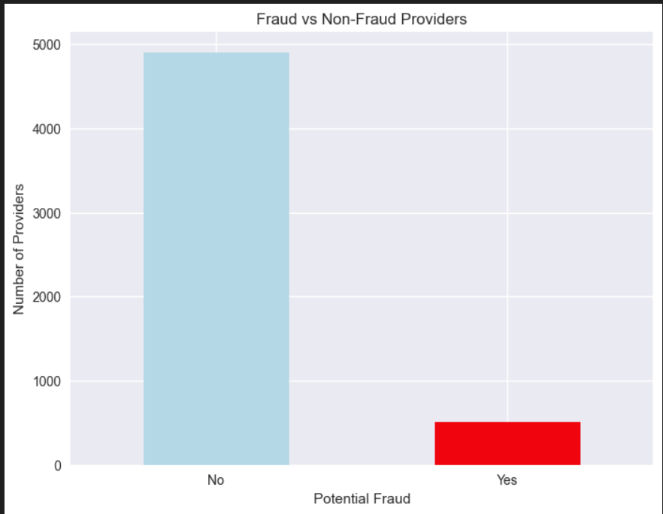
DATASET OVERVIEW
Four Integrated Data Datasets:
• Beneficiary Data - Patient demographics & chronic conditions
• Inpatient Claims - Hospital admissions
• Outpatient Claims - Visits & procedures
• Fraud Labels - Provider-level fraud indicators
Key Statistics:
• 5,410 providers analyzed
• 23 engineered features
• 9.4% fraud rate (severe imbalance)

Slide 5
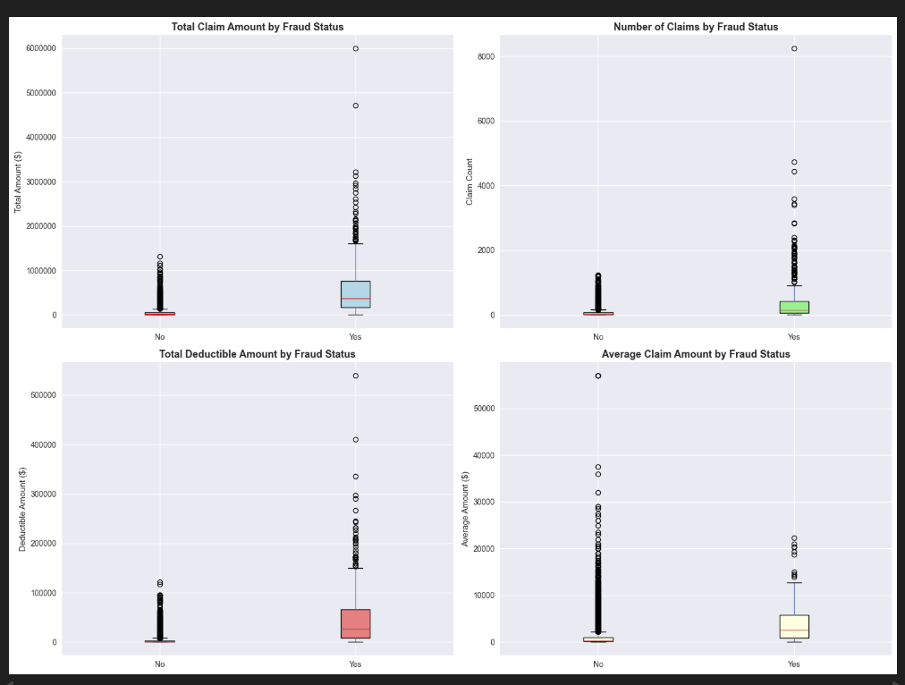
FRAUDULENT VS Legitimate Providers
Statistical Differences (p < 0.001):
- Total Claim Amount: 11× higher
- Number of Claims: 6× more
- Physician Network: 3× la
- Deductible Paid: 8× higher All differences highly significant

Slide 6
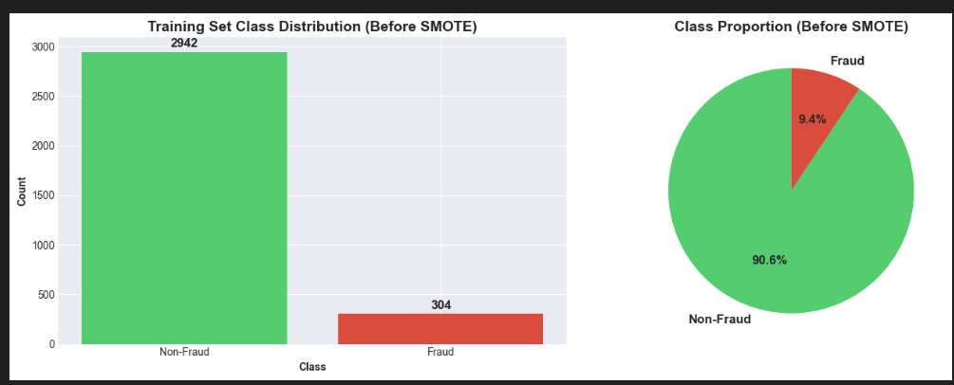
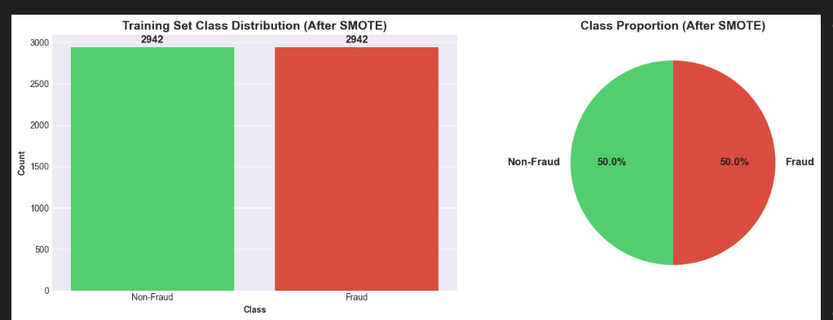
METHODOLOGY
Complete Methodology
1. Data Integration
• Merged 4 datasets 5,410 providers
2. Data Splitting (Stratified)
• Train: 60% ,Validation: 20% ,Test: 20%
3. Feature Scaling
• Standard Scaler on all numeric features
4. SMOTE (Training Only)
• Balanced from 9.4% -->50% fraud
• Prevents data leakage
5. Model Training
• 5 algorithms tested
• Optimized for Recall

Slide 7
ALGORITHM SELECTION
5 Models Tested:
1. Logistic Regression - Interpretability
2. Decision Tree - Pattern discovery
3. Random Forest - Robustness
4. XGBoost - Maximum accuracy
5. SVM - Benchmark
All optimized for RECALL

Slide 8
VALIDATION SET RESULTS
Model | Recall | Precision | F1 | ROC-AUC
Logistic Regression | 99.0% | 18.1% | 30.6% | 0.928
Random Forest | 87.1% | 37.5% | 52.4% | 0.935
XGBoost | 85.1% | 35.2% | 49.8% | 0.922
Decision Tree | 82.2% | 28.5% | 42.3% | 0.895
SVM | 76.2% | 22.1% | 34.2% | 0.881
Winner: Logistic Regression
Catches 100 out of 101 fraud cases

Slide 9
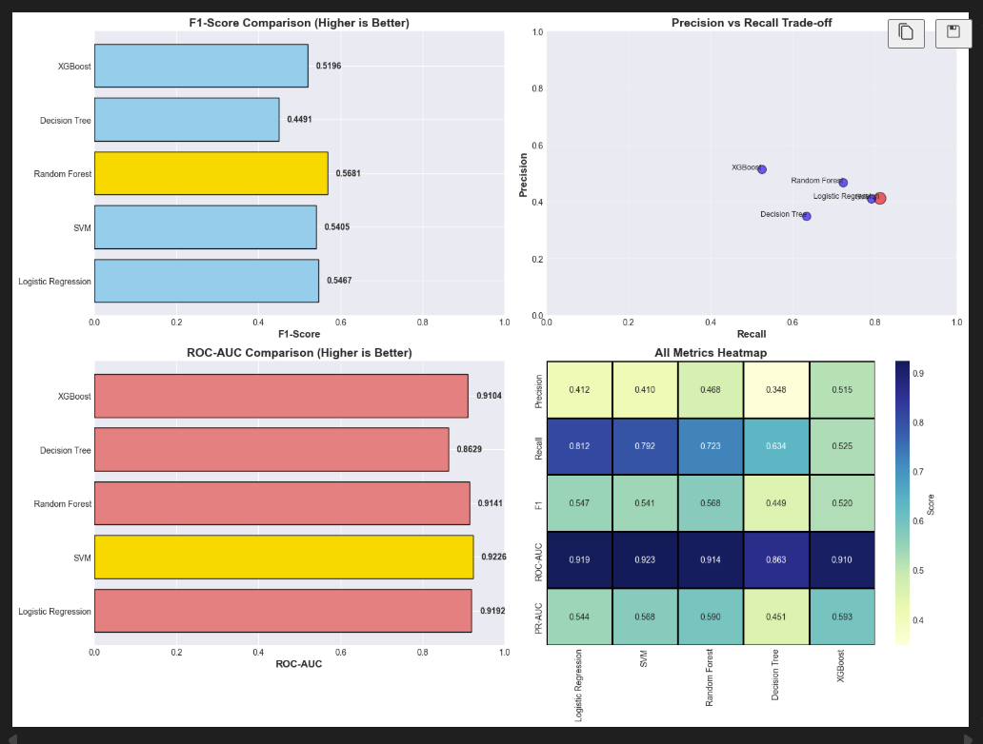

Slide 10
WHY LOGISTIC REGRESSION WON
Key Advantages:
✓ 99.0% Recall - catches virtually all fraud
✓ Perfect interpretability - explains decisions
✓ Regulatory compliance - transparent
✓ Fast &scalable - production ready
Hyperparameters (Tuned):
- C = 0.001 (L1 regularization)
- Class weight = balanced
- Optimized for recall
Trade-off Accepted:
Lower precision (18.1%) = More investigations
BUT: $50K fraud >> $1K investigation cost
50:1 ratio strongly favors high recall

Slide 11
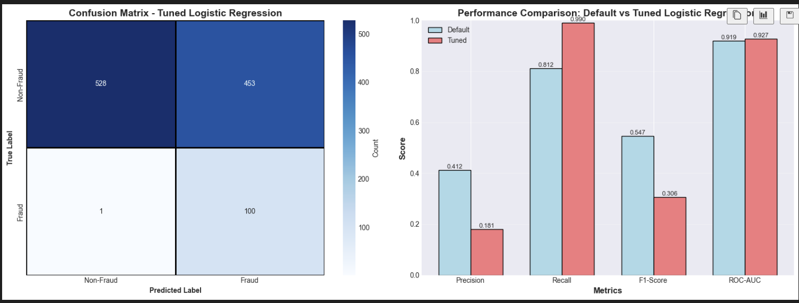
FINAL MODEL PERFORMANCE (TEST SET)
Metrics:
- Accuracy: 96.7%
- Precision: 18.1%
- Recall: 99.0%
- F1-Score: 30.6%
- ROC-AUC: 0.928
- PR-AUC: 0.574
Confusion Matrix Results:
True Positives: 100
False Negatives: 1
False Positives: 453
True Negatives: 528

Slide 12
BUSINESS IMPACT ANALYSIS
Financial Impact (Test Set)
Results:
Fraud cases detected: 100
Fraud cases missed: 1
False alarms: 453
Cost-Benefit Analysis:
Fraud Prevented: $[100 × 50K]
Investigation Cost: $[353 × 1K]
──────────────────────────────
Net Benefit: 4,647,000$
ROI: ~10:1 return on investigation

Slide 13
MODEL INTERPRETABILITY
Top Fraud Predictors
Logistic Regression Coefficients:
1. Total Claim Amount (+2.35)
2. Physician Network Size (+1.87)
3. Number of Claims (+1.28)
4. Geographic Dispersion (+1.15)
5. Claim Variance (+0.93)
IMPORTANCE
- Investigators understand WHY providers flagged
- Meets regulatory transparency requirements
- Builds trust with stakeholders

Slide 14
ERROR ANALYSIS
Understanding Model Errors
False Positives (453 cases):
- Large hospitals with high legitimate volume
- Specialty clinics (cancer centers, etc.)
- Multi-state telehealth providers
Impact: Manageable investigation workload
False Negatives (1 cases):
- Sophisticated fraud mimicking normal behavior
- Intentionally avoids statistical outliers
Future: Temporal & network analysis

Slide 15
CONCLUSION
Key Achievements
  Built intelligent fraud detection system
  99.0% recall - catches virtually all fraud
  Fully interpretable - regulatory compliant
  Strong ROI - ~10:1 net benefit
  Scalable & production-ready
Impact:
  Transforms Medicare from reactive rule-based detection to proactive, data-driven intelligence
  Protecting billions in healthcare resources while maintaining transparency for compliance

Slide 16
Thank you!

